Slide 1
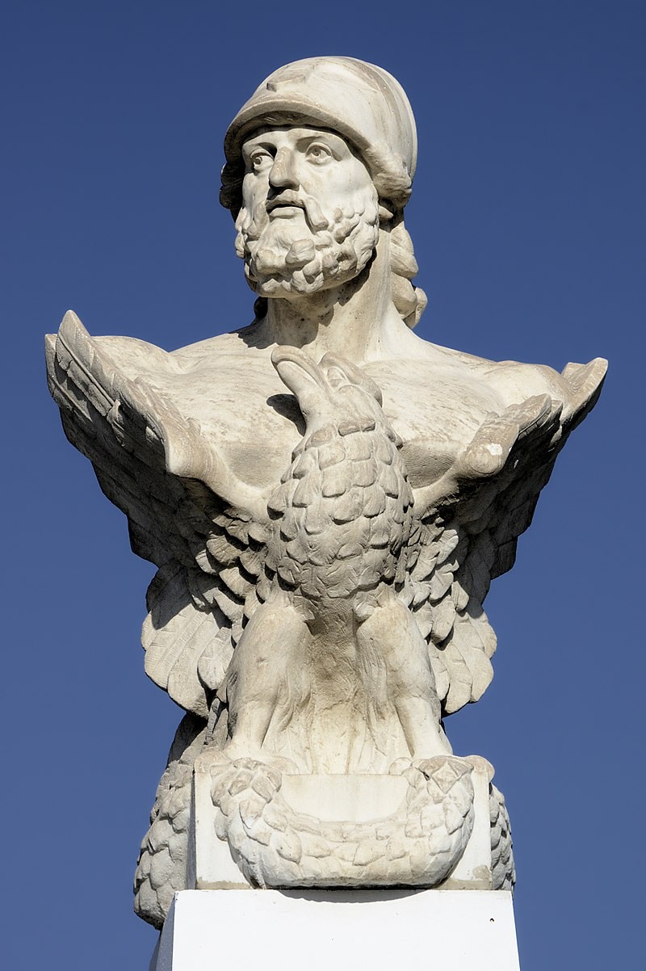
Cimon
By: Razmig Manjikian

Slide 2
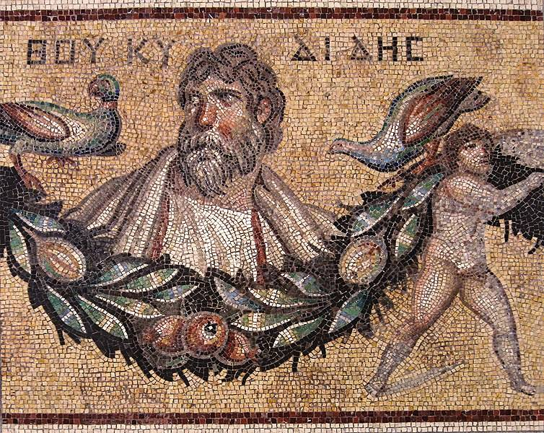
Early Childhood
Cimon was an Athenian politician and military leader who came from an aristocratic background.
Cimon was the son of Miltiades, a famous Athenian general who had led the Athenians to victory at the Battle of Marathon.
Cimon was born into a wealthy and influential family, and he likely received a good education and training in the arts of war and politics.
His upbringing played a role in shaping his character and his later achievements as a military leader and politician.

Slide 3
Cimon's power span
He was promoted to the highest honors and offices in Athens due to his amenable nature and the popularity he gained from his military exploits.
Cimon played a key role in humbling the Great King of Persia and subduing his pride.
His political career was not without controversy.
Cimon was criticized for his perceived arrogance and self-importance, which led to conflicts with other Athenian leaders.
he died while besieging Citium, possibly from an illness or a wound sustained in battle. Before his death, Cimon ordered his officers to conceal his death and sail away, so that neither the enemy nor the allies would know what had happened.
This allowed the force to be brought safely back to Athens "under the command of Cimon," even though he had been dead for thirty days.

Slide 4
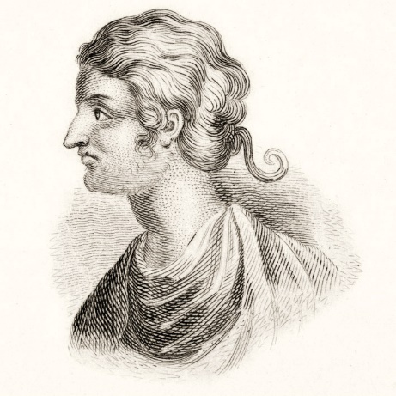
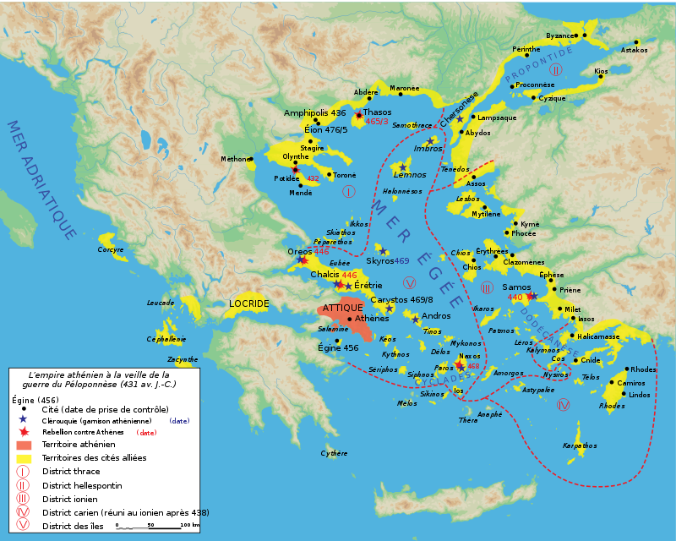
Reputation throughout his life
Had a good reputation early on in his life.
Cimon was tall and handsome, with an abundant crop of long curly hair. He was also known for his bravery and military prowess, and he won renown and good will for his role in the struggle at Salamis.
When Cimon embarked on his political career, the people of Athens welcomed him gladly.
Sated as they were with Themistocles, they promoted Cimon to the highest honors and offices in the city, for he was amenable, and his mildness and simplicity won him many friends.

Slide 5
Battle of Eurymedon in 466 BC.
This battle was fought against the Persians, who were attempting to expand their influence in the eastern Mediterranean.
Cimon led a fleet of Athenian ships to the coast of Asia Minor, where he engaged the Persian navy in a fierce battle. The Athenians were able to defeat the Persians and destroy many of their ships, which helped to secure Athenian dominance in the region.
The victory at Eurymedon was a significant achievement for Cimon and the Athenians, as it helped to expand Athenian power and influence in the eastern Mediterranean. It also demonstrated Cimon's military prowess and leadership skills, which helped to solidify his position as one of Athens' most respected military leaders.
Overall, the Battle of Eurymedon was one of Cimon's most important battles, and it played a key role in shaping the political and military landscape of ancient Greece.

Slide 6
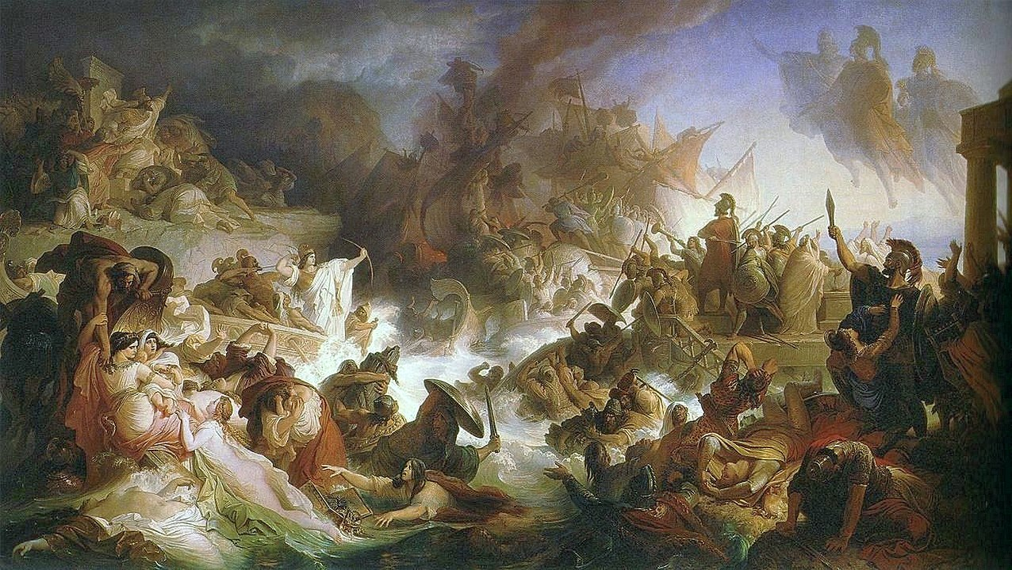

Slide 7
After his death and Conclusion
Cimon worked hard to build up the Athenian navy and to expand Athenian power and influence, and he played a key role in shaping the political and military landscape of ancient Greece. He used a system called cleruchy to spread Athenian empire, dividing lands won in military expeditions into lots and giving them out for free to Athenian citizens willing to emigrate.
After Cimon's death, no Greek general achieved any brilliant exploit against the barbarians, and the Greeks were turned against one another by demagogues and warmongers. Wars broke out between them, which weakened Greek power and gave the King of Persia a respite.
Overall, Cimon was a skilled military leader, a respected figure in Athenian politics, and a key player in the development of Athenian power and influence in ancient Greece. His legacy continues to be felt today, and he is remembered as one of the great leaders of ancient Athens.

Slide 8
Sources
https://topwar.ru/uploads/posts/2023-01/fukidid-na-mozaike-iz-dzherasha-pergamskij-muzej-berlin.jpg
https://classicalwisdom.com/wp-content/uploads/2020/12/1276px-Kaulbach_Wilhelm_von_-_Die_Seeschlacht_bei_Salamis_-_1868.jpeg
https://www.worldhistory.org/uploads/images/4571.png
https://britton-images.com/wp-content/uploads/2021/11/Cimon-c510-450-BC-was-an-Athenian-statesman-and-general-in-mid-5th-century-BC-Greece-the-son-of-Miltiades-the-victor-of-the-Battle-of-Marathon.jpg
https://upload.wikimedia.org/wikipedia/commons/thumb/a/ae/KimonSculpture.jpg/1200px-KimonSculpture.jpg

